Slide 1
COMP 282 Introduction to Database

Slide 3
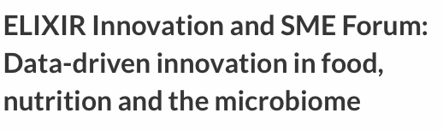
Big science is data driven.

Slide 4
Increasingly many companies see themselves as data driven.

Slide 5

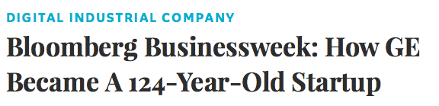
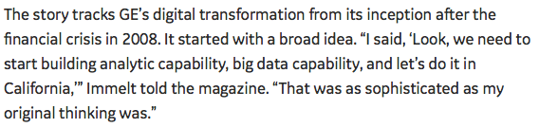
Even more “traditional” companies…

Slide 6
The world is increasingly driven by data…

Slide 7
Today’s Lecture
Introduction
Overview of the relational data model
Overview of DBMS topics: Key concepts & challenges

Slide 8
1. Introduction
Section 1

Slide 9
What you will learn about in this section
Section 1
Motivation for studying DBs
Overview of lecture coverage

Slide 10
Section 1 > Introduction
New tech. Same Principles.

Slide 11


Why should you study databases?
Section 1 > Introduction
Mercenary-make more $$$:
Startups need DB talent right away = low employee #
Massive industry…
Intellectual:
Science: data poor to data rich
No idea how to handle the data!
Fundamental ideas to/from all of CS:
Systems, theory, AI, logic, stats, analysis….
Many great computer systems ideas started in DB.

Slide 12
From a user’s perspective
Section 1 > Lectures
Foundations: Relational data models & SQL
How to manipulate data with SQL, a declarative language
reduced expressive power but the system can do more for you
Database Design: Design theory and constraints
Designing relational schema to keep your data from getting corrupted

Slide 13
Database internals
Section 1 > Lectures
3. Introduction to database systems
Data Storage and IO models
File Organization
4. Indexing and Hashing
Intro to indexing
B+ Tree, Hash Indexes
5. Query processing
Access methods and operators
Joins
Relational algebra and Query optimization

Slide 14
2. Overview of the relational data model
Section 2

Slide 15
What you will learn about in this section
Section 2
Definition of DBMS
Data models & the relational data model
Schemas & data independence

Slide 16
What is a DBMS?
Section 2 > DBMS
A large, integrated collection of data
Models a real-world enterprise
Entities (e.g., Students, Courses)
Relationships (e.g., Alice is enrolled in COMP440)
A Database Management System (DBMS) is a piece of software designed to store and manage databases

Slide 17
A Motivating, Running Example
Section 2 > Data models
Consider building a course management system (CMS):
Students
Courses
Professors
Who takes what
Who teaches what
Entities
Relationships

Slide 18
Data models
Section 2 > Data models
A data model is a collection of concepts for describing data
The relational model of data is the most widely used model today
Main Concept: the relation- essentially, a table
A schema is a description of a particular collection of data, using the given data model
E.g. every relation in a relational data model has a schema describing types, etc.

Slide 19
Modeling the Course Management System
Section 2 > Data models
Logical Schema
Students(sid: string, name: string, gpa: float)
Courses(cid: string, cname: string, credits: int)
Enrolled(sid: string, cid: string, grade: string)
sid | Name | Gpa
101 | Bob | 3.2
123 | Mary | 3.8
Relations
cid | cname | credits
564 | 564-2 | 4
308 | 417 | 2
Students
sid | cid | Grade
123 | 564 | A
Courses
Enrolled

Slide 20
Modeling the Course Management System
Section 2 > Data models
Logical Schema
Students(sid: string, name: string, gpa: float)
Courses(cid: string, cname: string, credits: int)
Enrolled(sid: string, cid: string, grade: string)
sid | Name | Gpa
101 | Bob | 3.2
123 | Mary | 3.8
Corresponding keys
cid | cname | credits
564 | 564-2 | 4
308 | 417 | 2
Students
sid | cid | Grade
123 | 564 | A
Courses
Enrolled

Slide 21
Other Schemata…
Section 2 > Schemata
Physical Schema: describes data layout
Relations as unordered files
Some data in sorted order (index)
Logical Schema: Previous slide
External Schema: (Views)
Course_info(cid: string, enrollment: integer)
Derived from other tables
Administrators
Applications

Slide 22
Data independence
Section 2 > Schemata
Concept: Applications do not need to worry about how the data is structured and stored
Logical data independence: protection from changes in the logical structure of the data
I.e. should not need to ask: can we add a new entity or attribute without rewriting the application?
Physical data independence: protection from physical layout changes
I.e. should not need to ask: which disks are the data stored on? Is the data indexed?
One of the most important reasons to use a DBMS

Slide 23
3. Overview of DBMS topics
Section 3
Key concepts & challenges

Slide 24
Database Management Systems
Database Management System = DBMS
A collection of files that store the data
Relational DBMS = RDBMS
Data files are structured as relations (tables)

Slide 25
Example of a Traditional Database Application
Suppose we are building a system
to store the information about:
students
courses
professors
who takes what, who teaches what

Slide 26
Can we do it without a DBMS ?
Sure we can! Start by storing the data in files:
students.txt courses.txt professors.txt
Now write C or Java programs to implement specific tasks

Slide 27
Doing it without a DBMS...
Enroll “Mary Johnson” in “COMP440”:
Write a C/Java program to do the following:
Read ‘students.txt’
Read ‘courses.txt’
Find&update the record “Mary Johnson”
Find&update the record “COMP440”
Write “students.txt”
Write “courses.txt”

Slide 28
Problems without an DBMS...
System crashes:
What is the problem ?
Large data sets (say 50GB)
Why is this a problem ?
Simultaneous access by many users
Lock students.txt – what is the problem ?
Read ‘students.txt’
Read ‘courses.txt’
Find&update the record “Mary Johnson”
Find&update the record “COMP440”
Write “students.txt”
Write “courses.txt”
CRASH !

Slide 29
Enters a DBMS
“Two tier system” or “client-server”
connection
(ODBC, JDBC)
Database server
Data files
Applications

Slide 30
Functionality of a DBMS
The programmer sees SQL, which has two components:
Data Definition Language - DDL
Data Manipulation Language - DML
query language
Behind the scenes the DBMS has:
Query engine
Query optimizer
Storage management
Transaction Management (concurrency, recovery)

Slide 31
How the Programmer Sees the DBMS
Start with DDL to create tables:
Continue with DML to populate tables:
CREATE TABLE Students (
Name CHAR(30)
SSN CHAR(9) PRIMARY KEY NOT NULL,
Category CHAR(20)
) . . .
INSERT INTO Students
VALUES(‘Charles’, ‘123456789’, ‘undergraduate’)
. . . .

Slide 32
How the Programmer Sees the DBMS
Tables:
Still implemented as files, but behind the scenes can be quite complex
Students:
Takes:
Courses:
“data independence” = separate logical view from physical implementation

Slide 33
Queries
Find all courses that “Mary” takes
What happens behind the scene ?
Query processor figures out how to answer the query efficiently.
SELECT C.name FROM Students S, Takes T, Courses C WHERE S.name=“Mary” and S.ssn = T.ssn and T.cid = C.cid

Slide 34
Queries, behind the scene
Declarative SQL query
Imperative query execution plan:
sname
SELECT C.name
FROM Students S, Takes T, Courses C
WHERE S.name=“Mary” and
S.ssn = T.ssn and T.cid = C.cid
cid=cid
sid=sid
name=“Mary”
Students
Takes
Courses
The optimizer chooses the best execution plan for a query

Slide 35
Database Systems
The big commercial database vendors:
Oracle
IBM (with DB2)
Microsoft (SQL Server)
Sybase
Some free database systems:
Postgres
MySQL
Predator

Slide 36
Roles in Design, Implementation, and Maintenance of a DBs
System Analyst - specifies system using input from customer; provides complete description of functionality from customer’s and user’s point of view
Data Scientists: use all available data sources (internal and external) to analyze and gain insights to help decision makers.
Database Designer - specifies structure of data that will be stored in database.

Slide 37
Roles in Design, Implementation and Maintenance of a DBs (con’t)
Application Programmer - implements application programs (transactions) that access data and support enterprise rules
Database Administrator - maintains database once system is operational: space allocation, performance optimization, database security
System Administrator - maintains transaction processing system: monitors interconnection of HW and SW modules, deals with failures and congestion

Slide 38
Database Architecture
The architecture of a database systems is greatly influenced by
the underlying computer system on which the database is running:
Database systems structure
Centralized databases
One to a few cores, shared memory
Client-server
One server machine executes work on behalf of multiple client machines.
Parallel databases
Many core shared memory
Shared disk
Shared nothing
Distributed databases
Geographical distribution
Schema/data heterogeneity
Notes:
38

Slide 39
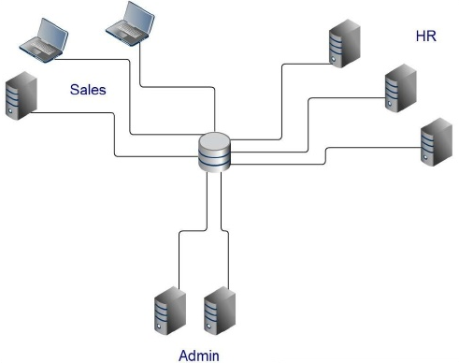
Centralized Database

Slide 40
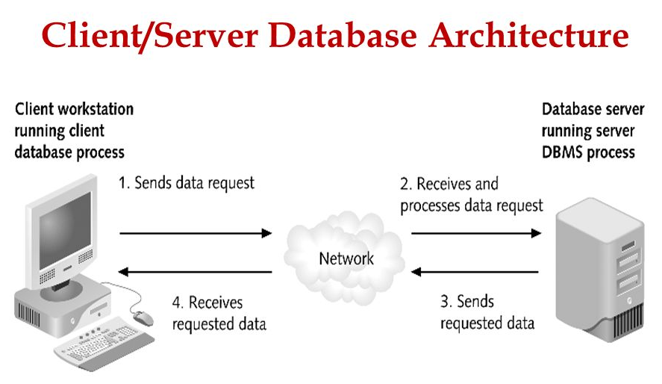
One server machine executes work on behalf of multiple client machines.

Slide 41
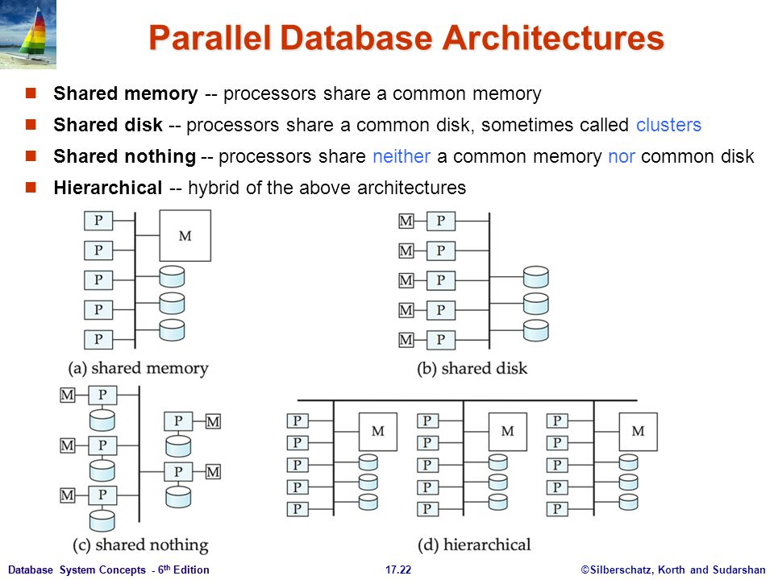
Parallel Database
Many core shared memory
Shared disk
Shared nothing
Notes:
Parallel database systems consist of multiple processors and multiple disks connected by a fast interconnection network.

Slide 42
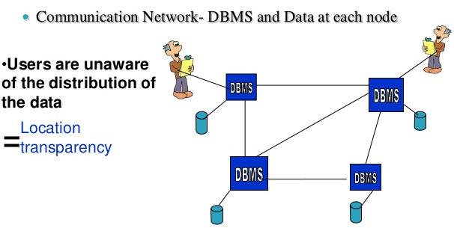
Distributed Database
Geographical distribution

Slide 43
Example 1
show databases;
CREATE database test;
use test;
CREATE TABLE member ( name varchar(50),
email varchar(100),
country varchar(50), PRIMARY KEY (name));
INSERT INTO member VALUES ('Smith‘, ‘smith@gmail.com’, ‘USA’);
SELECT * from member;

Slide 44
Example 2
CREATE TABLE employee ( empID int(11) NOT NULL AUTO_INCREMENT, firstName varchar(100) DEFAULT NULL, PRIMARY KEY (empID));
INSERT INTO employee( firstName) VALUES ('Smith');
SELECT * from employee;

